Slide 1

Experience Machines and Reality: the Finishing Touch - Nicholas Barrow, Patrick Haggard
University College London
Action and Body Lab
Institute of Cognitive Neuroscience

Slide 2
Outline
What’s an experience machine?
Do we have experience machines now?
What are we missing? → Touch
Ethical considerations

Slide 3
Outline
What’s an experience machine?
Do we have experience machines now?
What are we missing? → Touch
Ethical considerations

Slide 4
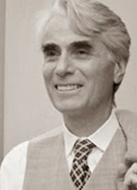
Suppose there was an experience machine that would give you any experience you desired. Superduper neuropsychologists could stimulate your brain so that you would think and feel you were writing a great novel, or making a friend, or reading an interesting book. All the time you would be floating in a tank, with electrodes attached to your brain. Should you plug into this machine for life, preprogramming your life experiences?
- Robert Nozick, Anarchy State and Utopia, 1974 p. 42

Slide 5
Suppose there was an experience machine that would give you any experience you desired. Superduper neuropsychologists could stimulate your brain so that you would think and feel you were writing a great novel, or making a friend, or reading an interesting book. All the time you would be floating in a tank, with electrodes attached to your brain. Should you plug into this machine for life, preprogramming your life experiences?
- Robert Nozick, Anarchy State and Utopia, 1974 p. 42

Slide 6
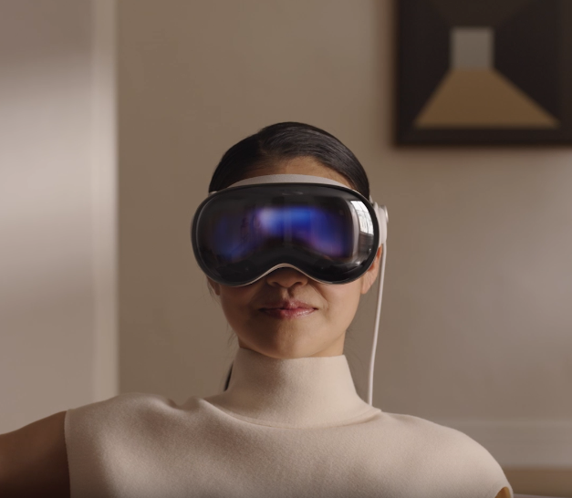
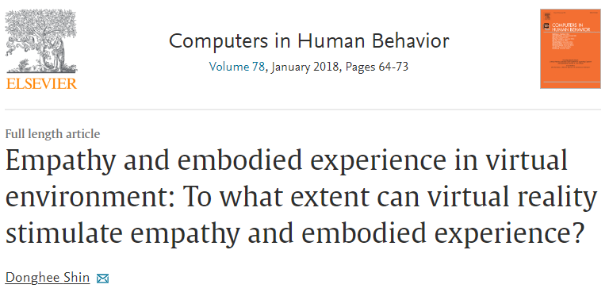
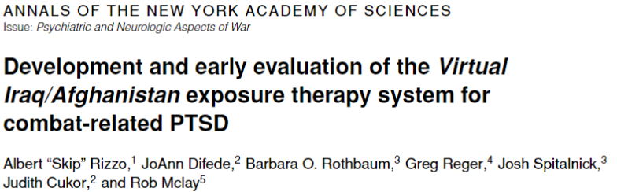
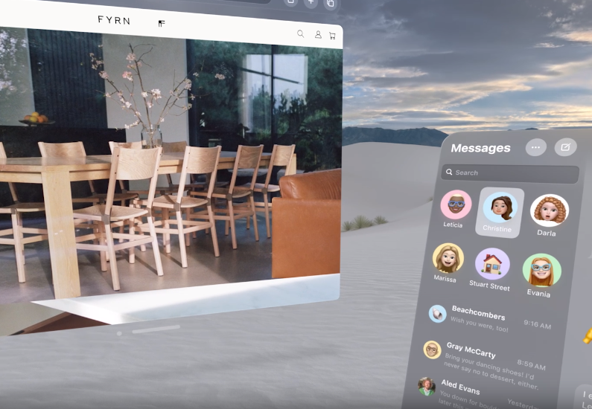

Experience machines manipulate our conscious experience
Screenshots from Apple’s recent ‘VisionPro’ showcase

Slide 7
Outline
What’s an experience machine?
Do we have experience machines now?
What are we missing? → Touch
Ethical considerations

Slide 8
Suppose there was an experience machine that would give you any experience you desired. Superduper neuropsychologists could stimulate your brain so that you would think and feel you were writing a great novel, or making a friend, or reading an interesting book. All the time you would be floating in a tank, with electrodes attached to your brain. Should you plug into this machine for life, preprogramming your life experiences?
- Robert Nozick, Anarchy State and Utopia, 1974 p. 42

Slide 9

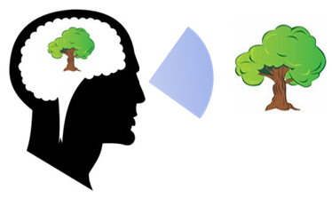

Working assumption:
successful manipulation of experience → manipulation of belief
Stimulus
Experience
Belief
Stimulus Parameter
(image displayed on VR headset)
“It looks like a tree”;
“*this* is what it is like to experience a tree”
“I am looking at a tree”;
“There is a tree in front of me”

Slide 10


Stimulus
Experience
Belief
*reach out to touch tree*

Slide 11

Currently, we can only manipulate experiences that although seem real, do not feel real
Stimulus
Experience
Belief
Stimulus Parameter
(image displayed on VR headset)
“It looks like a tree”;
“*this* is what it is like to experience a tree”
“I am looking at a tree”;
“There is a tree in front of me”

Slide 12
Outline
What’s an experience machine?
Do we have experience machines now?
What are we missing? → Touch
Ethical considerations

Slide 13
How Touch Facilitates Realism
Agency/Active Touch
Body as medium for interaction with the external world (Enactivist type thinking (O’Regan and Noe, 2001))
Relation to Self
Self ↔ Body (Cataldo (in prep))
Body Boundaries (de Vignemont, 2018)
Sensory Coherence
Arbiter of reality (Fairhurst et.al., 2018)

Slide 14

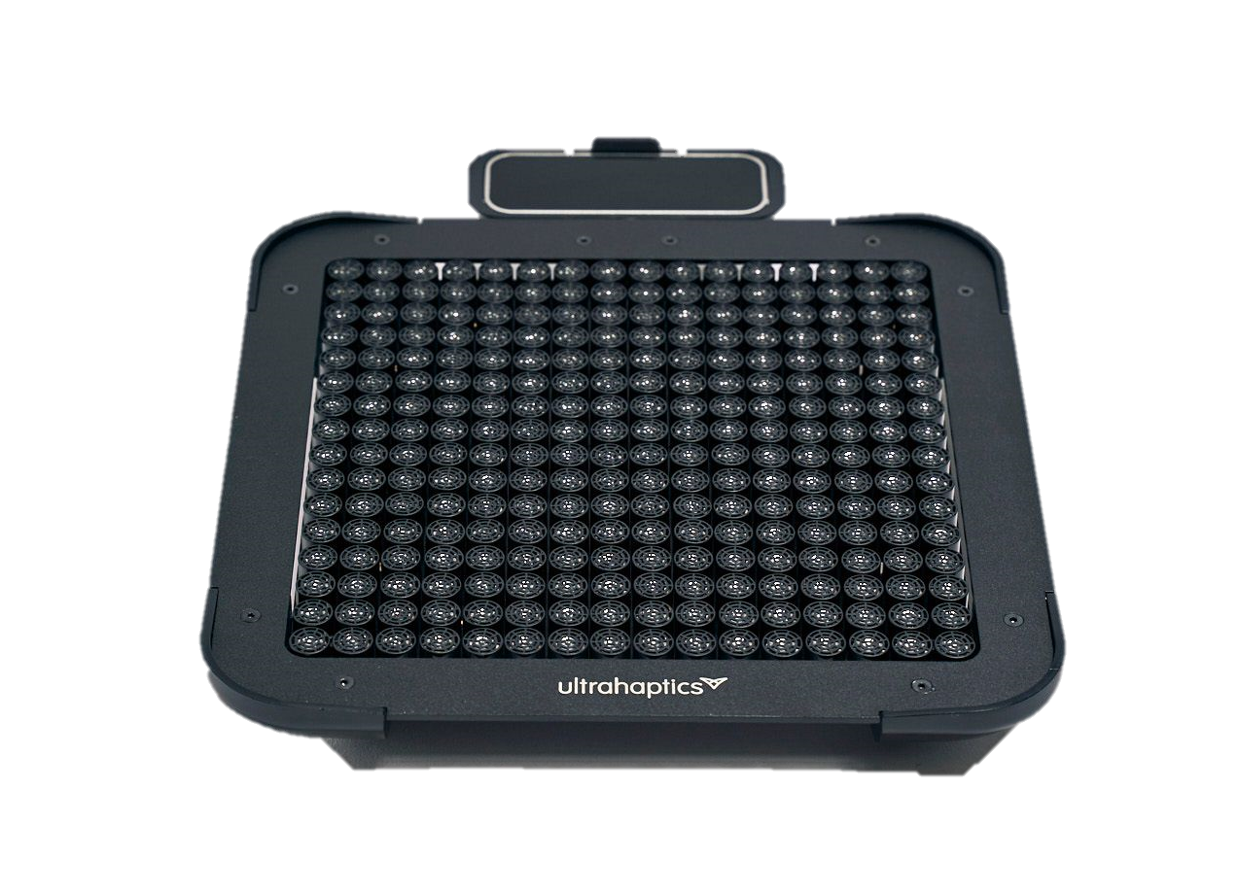
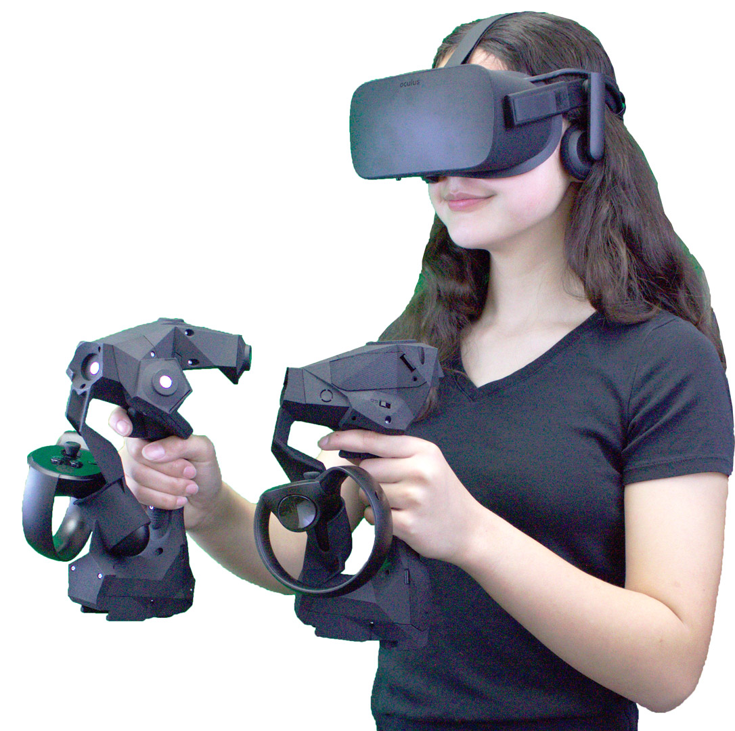
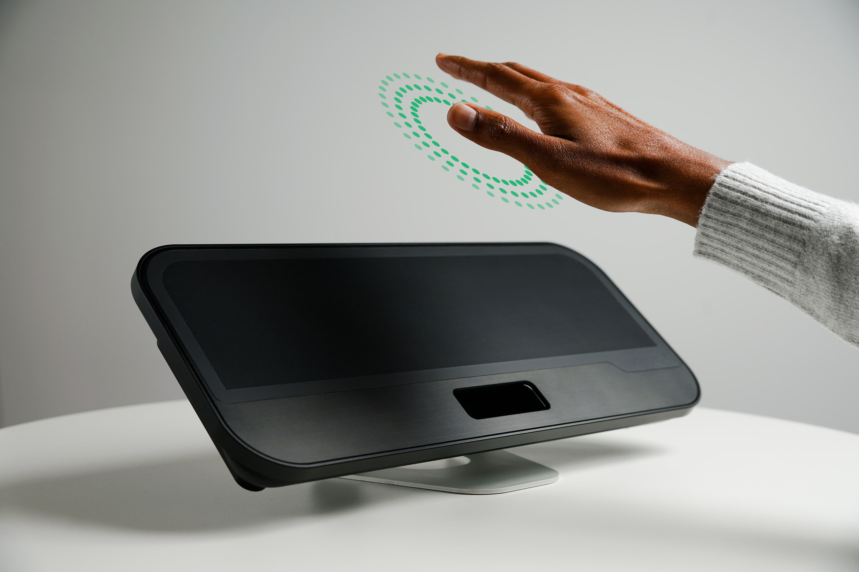
Haptic Technology: Limitations
An ‘Ultraleap’ haptic device that uses ultrasound to stimulate tactile sensation.
A ‘B-Haptics’ Haptic Vest
A combination of handheld haptic controllers and virtual reality headset
An illustration of touchless haptic technology.

Slide 15
Outline
What’s an experience machine?
Do we have experience machines now?
What are we missing? → Touch
Ethical considerations

Slide 16
Suppose there was an experience machine that would give you any experience you desired. Superduper neuropsychologists could stimulate your brain so that you would think and feel you were writing a great novel, or making a friend, or reading an interesting book. All the time you would be floating in a tank, with electrodes attached to your brain. Should you plug into this machine for life, preprogramming your life experiences?
- Robert Nozick, Anarchy State and Utopia, 1974 p. 42

Slide 17
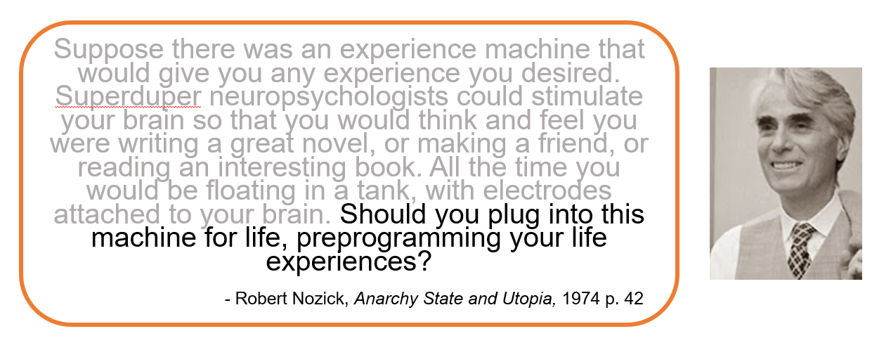
Moral Context: We value real experiences over virtual ones
But they clearly matter to some degree
Virtual experiences evoke real emotions and can interfere with our subsequent experiences of reality

Slide 18
Manipulating Perceptual Belief: Ethical Considerations
Sensory Autonomy and Consent
Body Representation
Body Disownership → Prefer virtual body
Sensory Incoherence
Touch no longer arbiter of reality
Touch is ‘always on’
‘Get your hands off me!’
Unable to feel own body
Tactile Deception?

Slide 19
To sum up:
Experience Machines = Technology that manipulate experience
‘Successful’ experience machines will also manipulate belief
Current technology is unable to do this
The missing piece is tactile experience
However, technology that facilitates realism in such a convincing way risks ethical harm

Slide 20





Thank you for listening
nicholas.barrow@ucl.ac.uk
Nicholas Barrow
-
University College London
Prof. Patrick Haggard
-
University College London
Notes:
Write to Orestis what the talk is, what is about, when it is. Ask for touchless template

